Slide 1
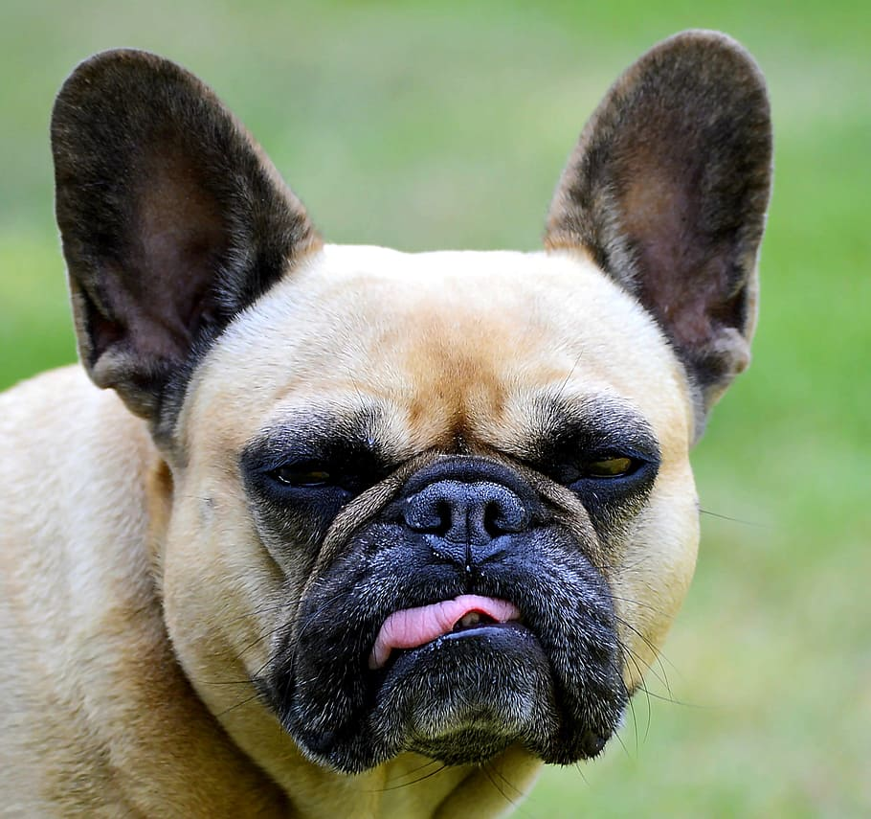
Photo Caption / Meme Challenge
Type your photo caption here...

Slide 2
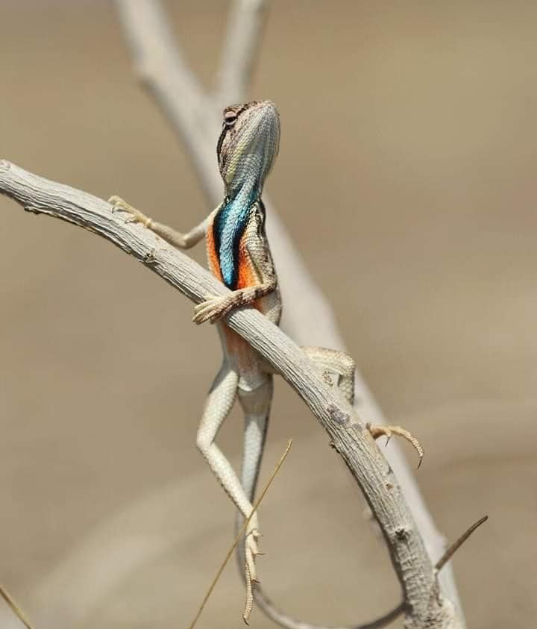
Photo Caption / Meme Challenge
Type your photo caption here...

Slide 3
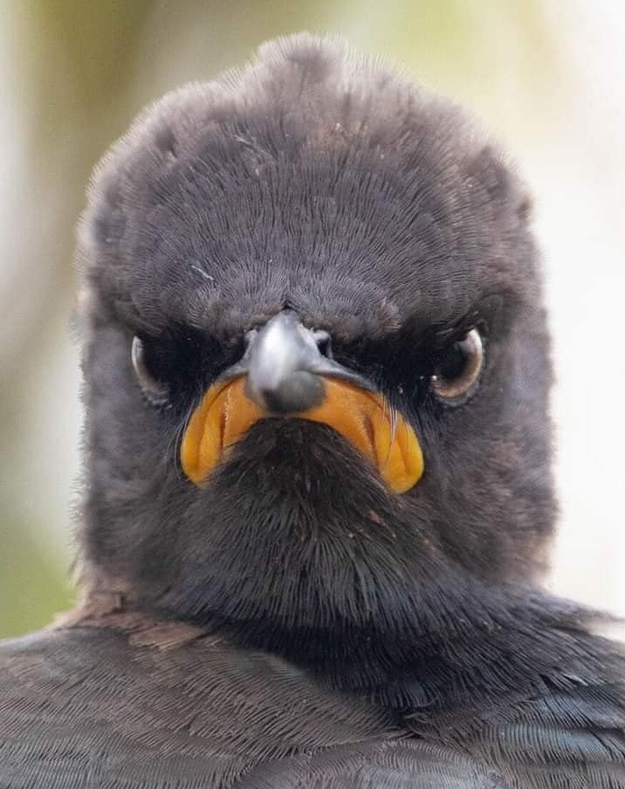
Photo Caption / Meme Challenge
Type your photo caption here...

Slide 4
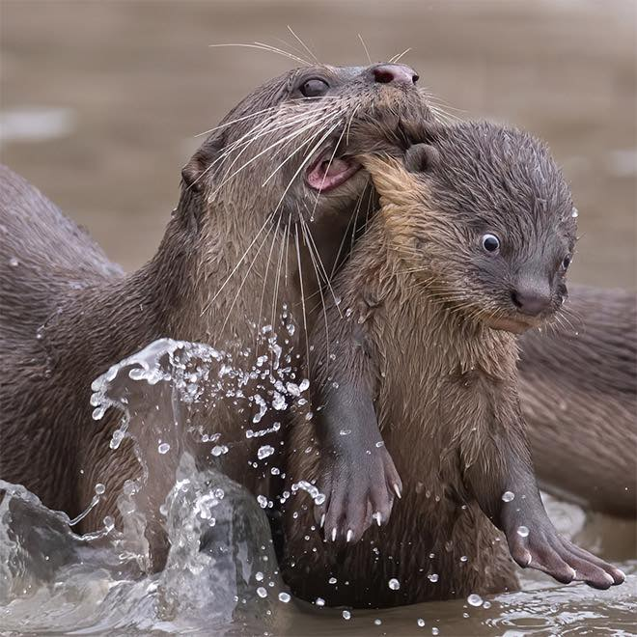
Photo Caption / Meme Challenge
Type your photo caption here...

Slide 5
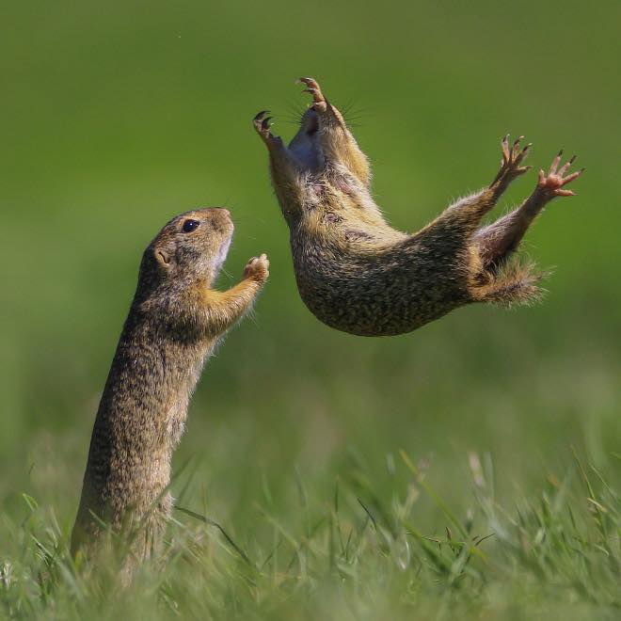
Photo Caption / Meme Challenge
Type your photo caption here...

Slide 6
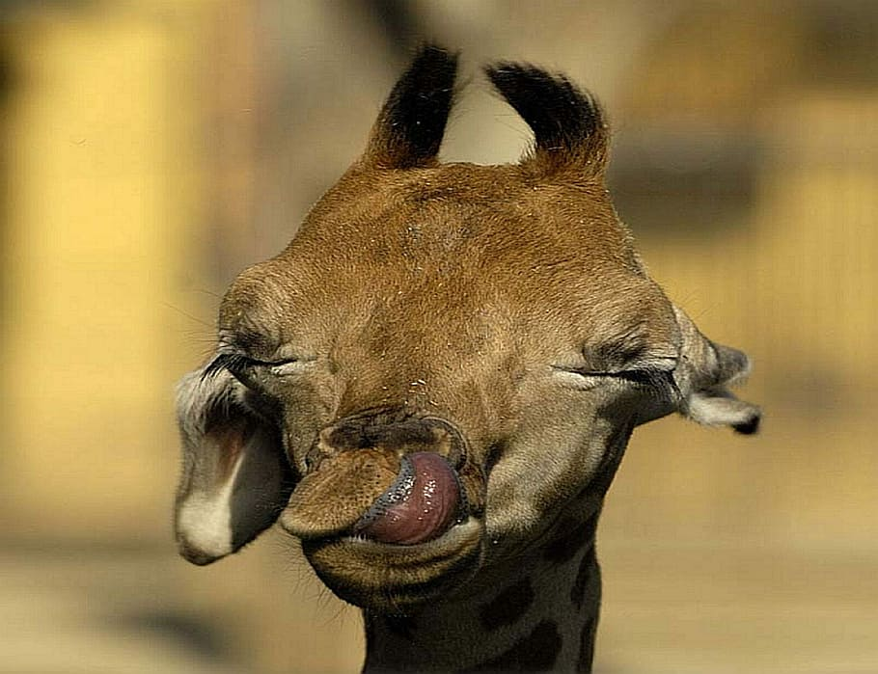
Photo Caption / Meme Challenge
Type your photo caption here...

Slide 7
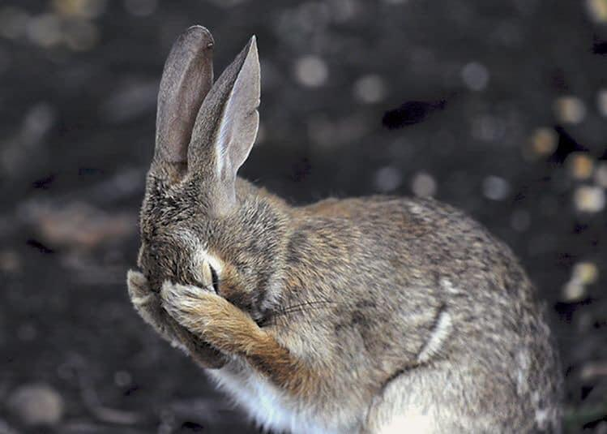
Photo Caption / Meme Challenge
Type your photo caption here...

Slide 8
Photo Caption / Meme Challenge
Type your photo caption here...

Slide 9
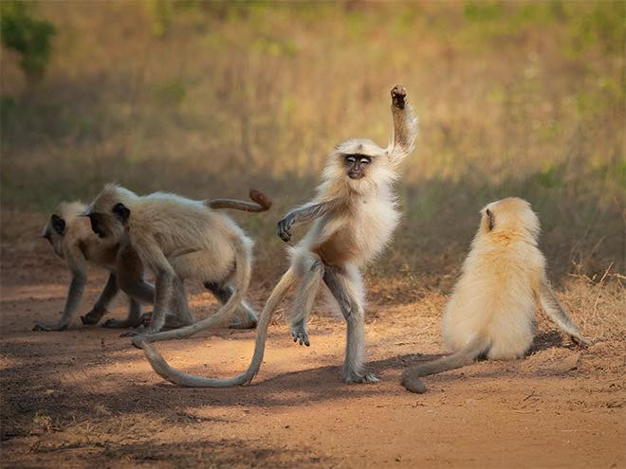
Photo Caption / Meme Challenge
Type your photo caption here...

Slide 10
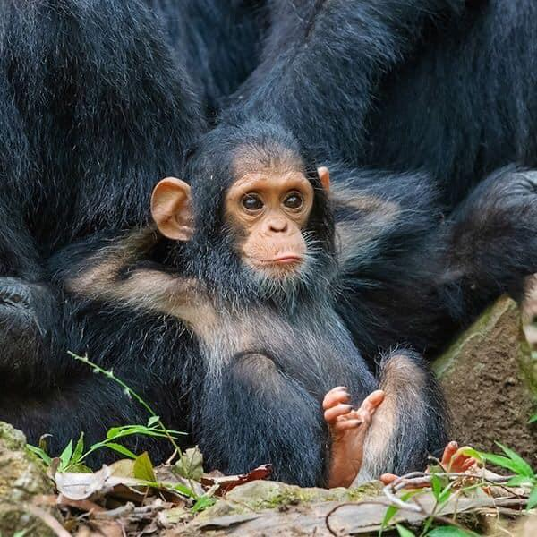
Photo Caption / Meme Challenge
Type your photo caption here...

Slide 11
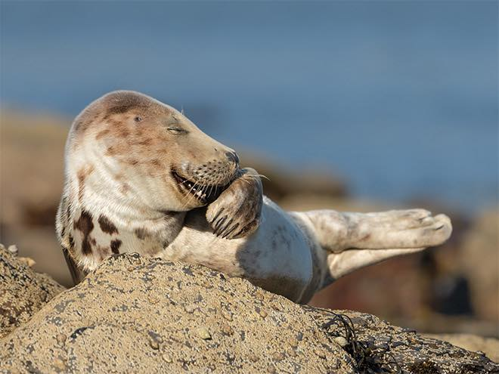
Photo Caption / Meme Challenge
Type your photo caption here...

Slide 12
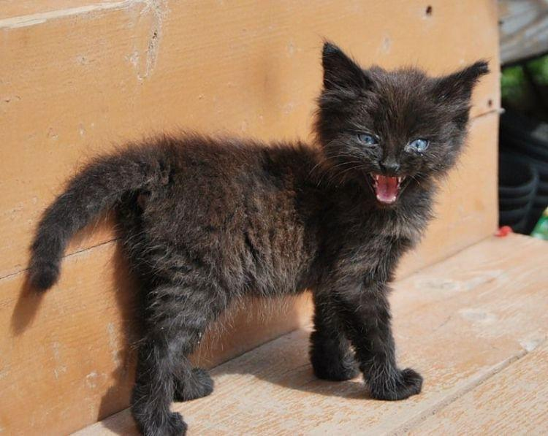
Photo Caption / Meme Challenge
Type your photo caption here...

Slide 13
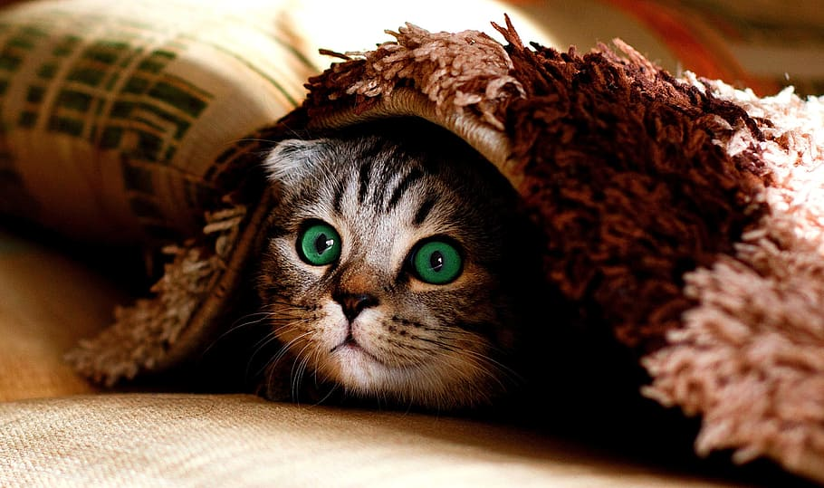
Photo Caption / Meme Challenge
Type your photo caption here...

Slide 14
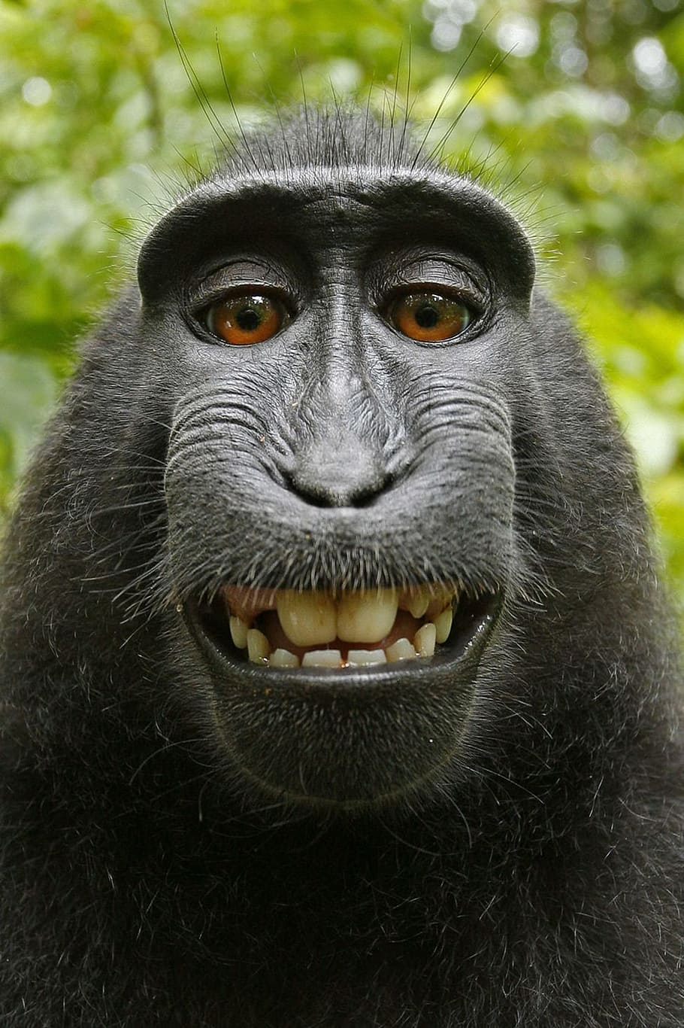
Photo Caption / Meme Challenge
Type your photo caption here...

Slide 15
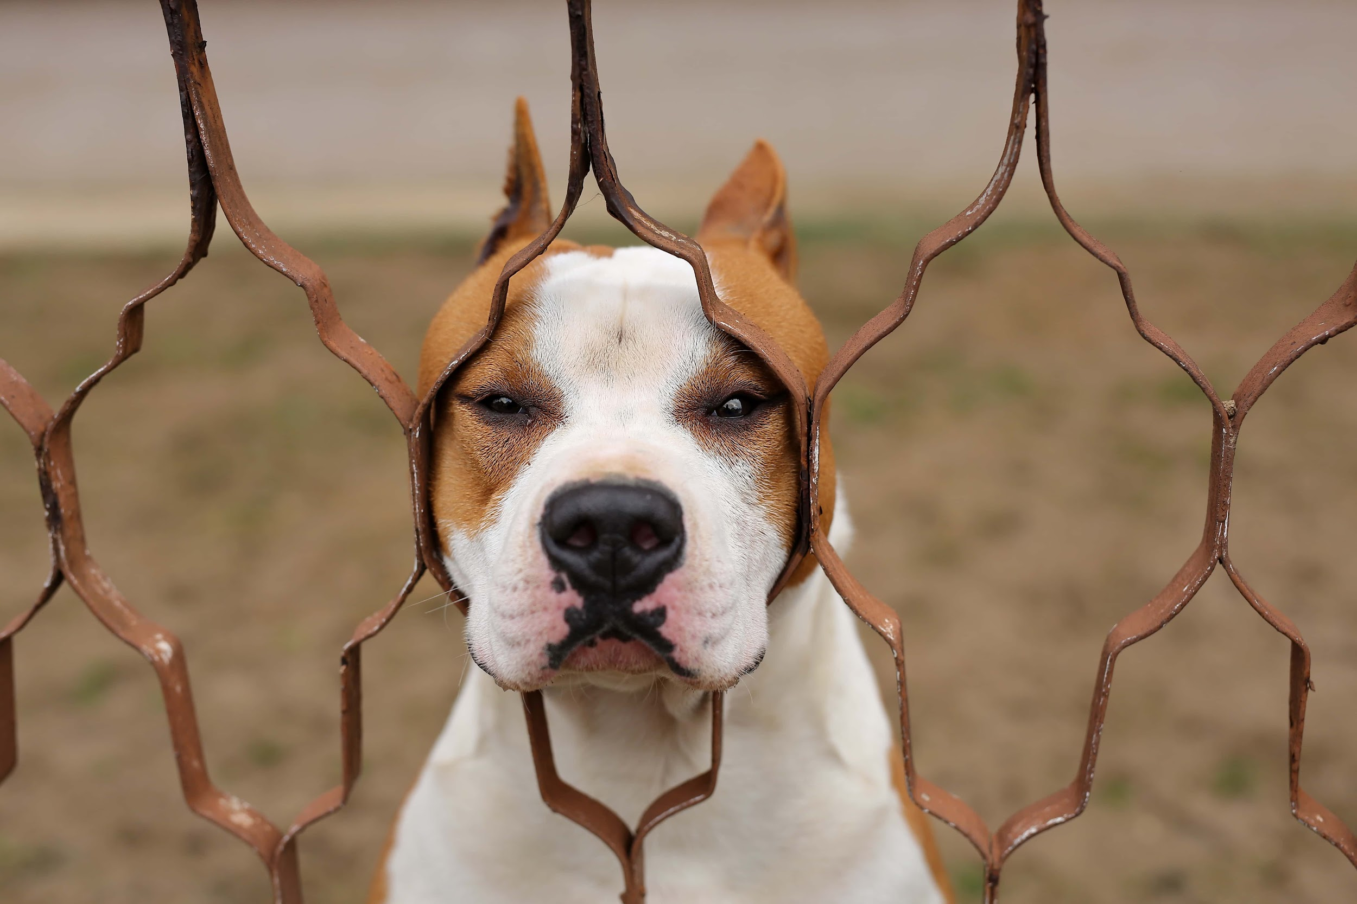
Photo Caption / Meme Challenge
Type your photo caption here...

Slide 16
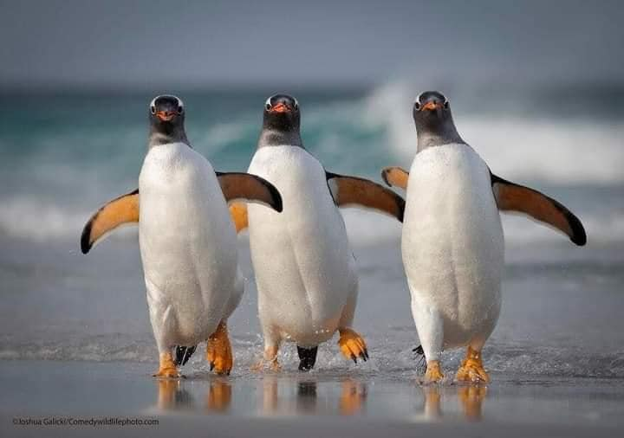
Photo Caption Challenge
Type your photo caption here...

Slide 17
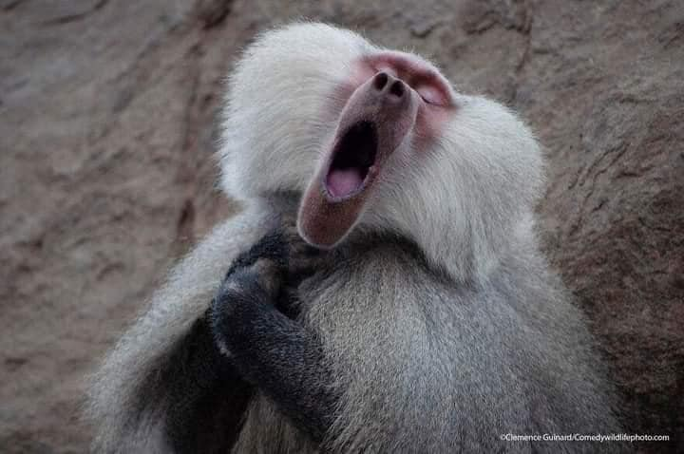
Photo Caption Challenge
Type your photo caption here...

Slide 18
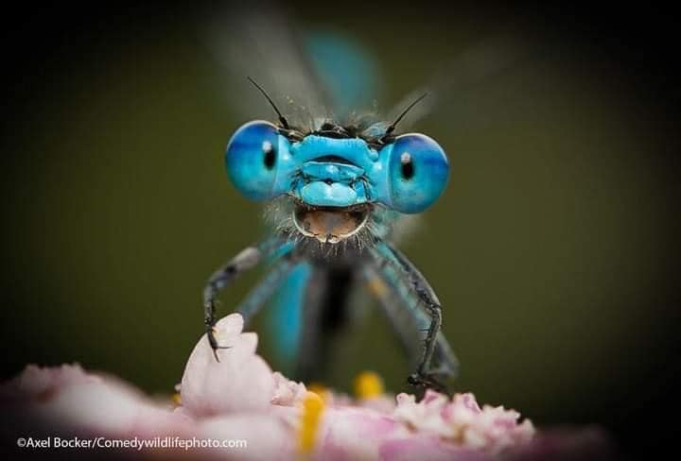
Photo Caption Challenge
Type your photo caption here...

Slide 19
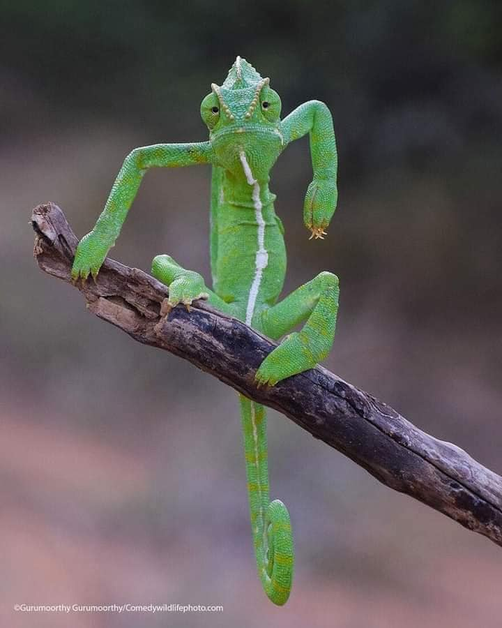
Photo Caption / Meme Challenge
Type your photo caption here...

Slide 20
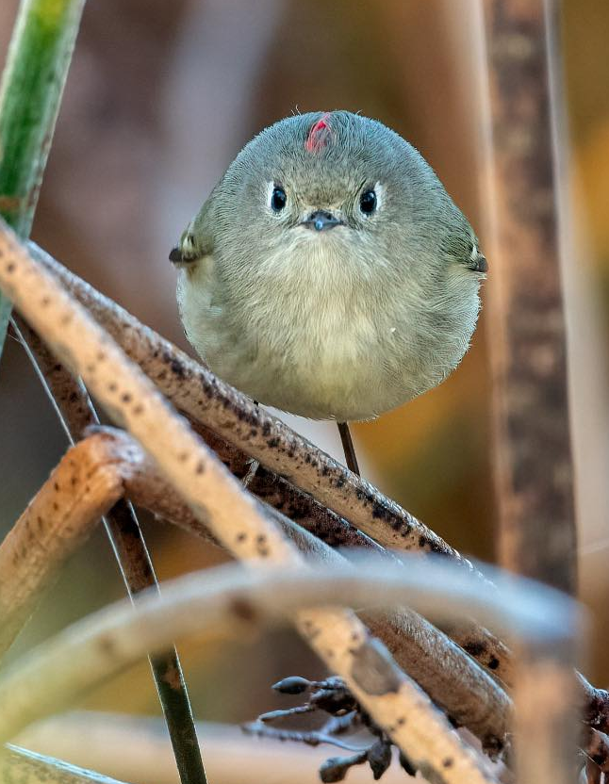
Photo Caption / Meme Challenge
Type your photo caption here...

Slide 21
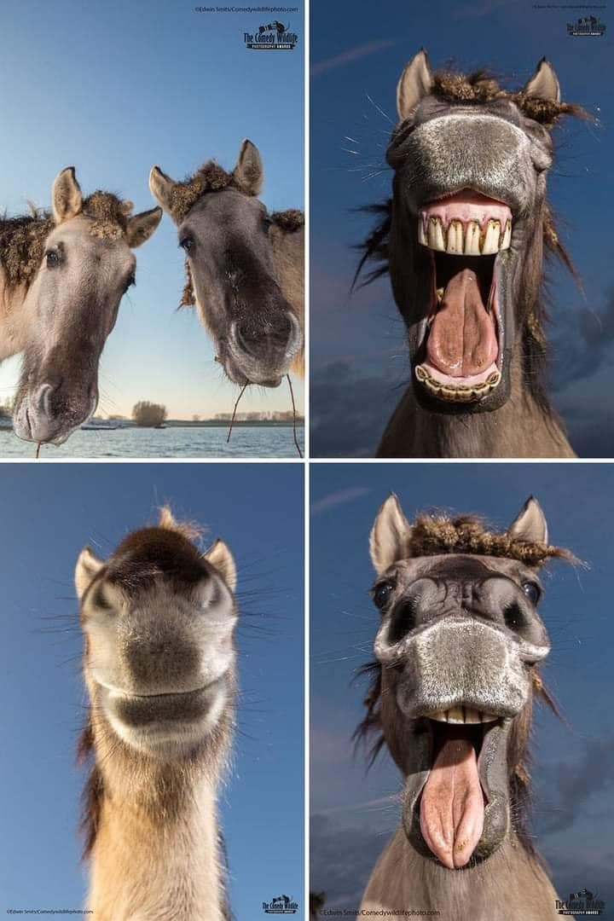
Photo Caption Challenge
Type your photo caption here...

Slide 22
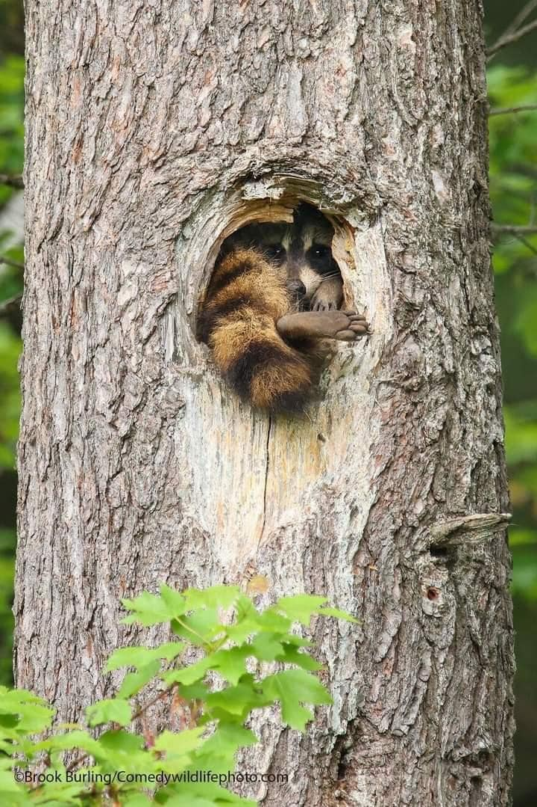
Photo Caption Challenge
Type your photo caption here...

Slide 23
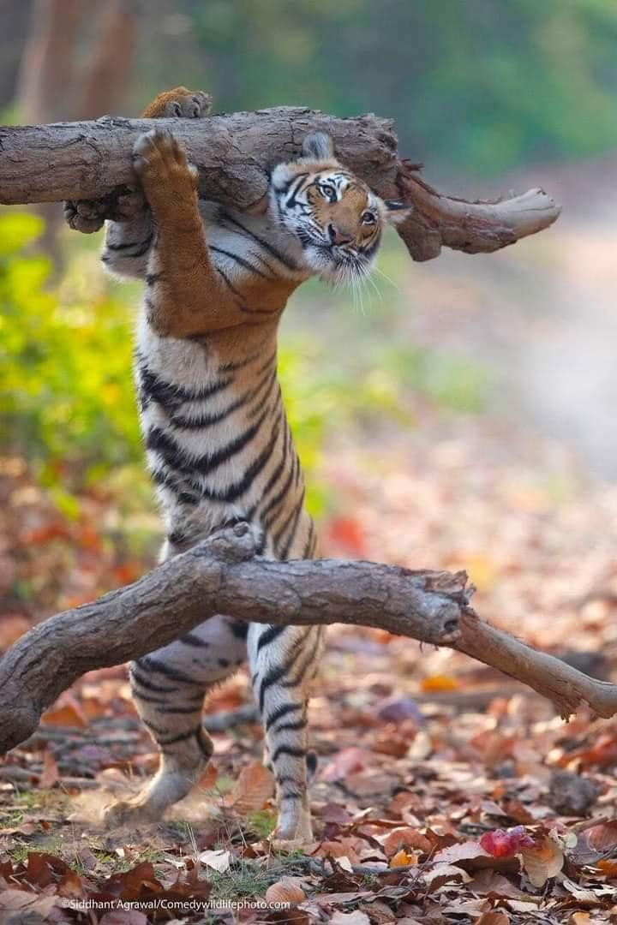
Photo Caption Challenge
Type your photo caption here...

